Slide 1
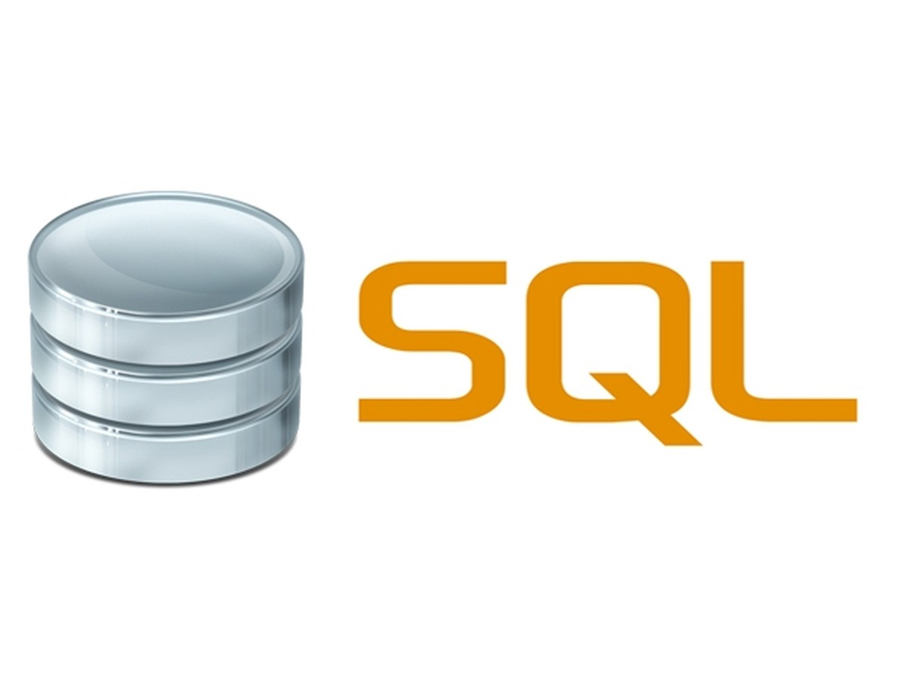

Slide 2
SQL
SQL is a standard language for storing, manipulating and retrieving data in databases.
Our SQL tutorial will teach you how to use SQL in: MySQL, SQL Server, MS Access, Oracle, Sybase, Informix, Postgres, and other database systems.

Slide 3
Web resource
https://www.w3schools.com/sql/

Slide 4


Slide 5
PostgreSQL Downloads
Main postgress page: https://www.postgresql.org/
Linux: https://www.postgresql.org/download/linux/
MacOs: https://www.postgresql.org/download/macosx/
Windows: https://www.postgresql.org/download/windows/

Slide 6
How to Download PostgreSQL & Install PostgreSQL on Windows
https://www.guru99.com/download-install-postgresql.html

Slide 7
What is SQL?
SQL stands for Structured Query Language
SQL lets you access and manipulate databases
SQL became a standard of the American National Standards Institute (ANSI) in 1986, and of the International Organization for Standardization (ISO) in 1987

Slide 8
What Can SQL do?
SQL can execute queries against a database
SQL can retrieve data from a database
SQL can insert records in a database
SQL can update records in a database
SQL can delete records from a database
SQL can create new databases
SQL can create new tables in a database
SQL can create stored procedures in a database
SQL can create views in a database
SQL can set permissions on tables, procedures, and views

